Slide 1
DETECTION OF WEEDS IN THE CROP FIELD USING MACHINE LEARNING

Slide 2
BACHELOR OF TECHNOLOGY
IN
ELECTRONICS AND COMMUNICATION ENGINEERING
BATCH NO: 01
UNDER THE GUIDANCE OF ASSOCIATE PROFESSOR
Mr.P.S.J. SREERAM, M.Tech.
PROJECT MEMBERS:
V.P L PADMAJA | 176K1A0454
I.S.S.SAMEERA | 176K1A0420
S.HARIPRASAD .M | 176K1A0459
D.RAKESH | 176K1A0414
D.CHITHRA MEGHANA | 176K1A0411

Slide 3
ABSTRACT:
Now a days the agrochemicals spraying techniques results either in over dosing or in under dosing which have their own disadvantages.
So we design a real-time computer vision based crop/weed detection web application.
This application takes the images as input and it will generate an analysis report on how much percentage of weed and crop are present.
Agrochemical spraying will be done by the farmer based on the report generated by the web application.

Slide 4
INTRODUCTION:
Weeds are the unwanted plants that regrow vigorously and are the strongest yield-reducers resulting in 10 to 20% of yield losses.
Our proposed system provides an web application which detects the percentage of weed present.
In our system, we try to increase the accuracy using possibly less number of better Machine Learning techniques than those used in the existing system.
The outcome of this project work is a machine learning-based vision system having the capability to detect weeds and can, therefore, be used for precise weed control.

Slide 5
OBJECTIVES:
The main objective of this project is to design a scalable application which reduces manpower in detecting weed and crop.
To improve the accuracy better than that of the existing system.

Slide 6
EXISTING SYSTEM:
The existing system framework for agrochemical spraying comprises two subsystems namely:
a) Vision system: The complete approach is explained in the following subsections.
Crop / Weed detection: The different phases involved are:
Image / Data acquisition
Pre-processing
Image segmentation
Features
Training
Random forest algorithm
b) Fluid flow control or spray actuation/application system: This consists of a spraying system which comprised of a 4-wheeler trolley.

Slide 7

DISADVANTAGES:
The initial investment to purchase such a system will be very high.
Also, the maintenance cost would be high to keep the system in good condition
The spraying system may sometimes get overloaded.
It may also give a false mixture of chemicals.

Slide 8
PROPOSED SYSTEM:
Block diagram of Proposed System:
Training phase
Testing phase
Training Dataset
Pre-Processing
Features Extraction
Training
(CNN)
Pre-Processing
Features Extraction
Testing Dataset
Classifier
LABEL

Slide 9
The proposed framework is actually a web application which is scalable.
This application will take the images of crops, weeds and combination of both as input.
Some Machine Learning Techniques will be applied to process those images and will generate a dataset from those processed images.
We have two phases Training Phase and Testing Phase.
In Training Phase, the dataset generated is used to train the Supervised Machine Learning model.
Once the model is trained completely it will be able to detect crop and weed in testing phase.
Then the application will generate a report on how much percentage of crop and weed are present.

Slide 10

ADVANTAGES:
Since this is an application, there is no need of money, it is free of cost. All they need is a Smartphone to click the photos of crop and weed.
It will provide a better accuracy than the existing system.
The application is scalable and can be able to run on any type of device.

Slide 11

SOFTWARE REQUIREMENTS:
Jupyter Notebook
Libraries
Tensorflow
Keras
Math
Matplotlib
NumPy
Skimage

Slide 12
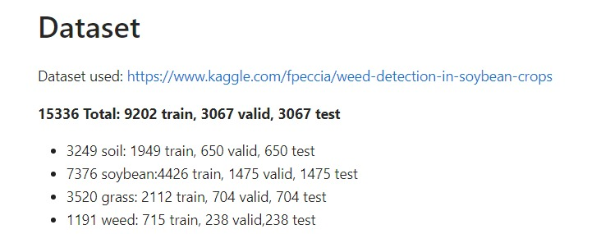
Software Implementation

Slide 13
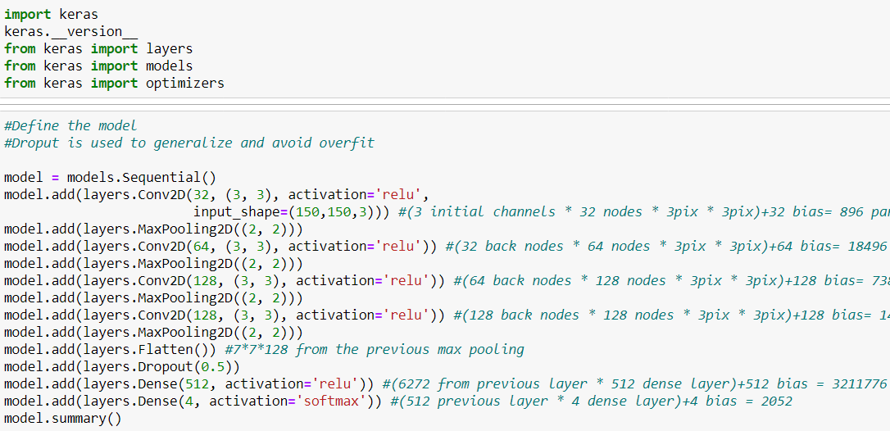
Model

Slide 14
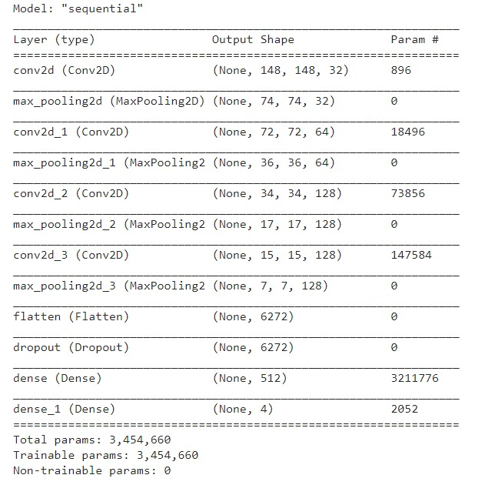
Model Specification

Slide 15
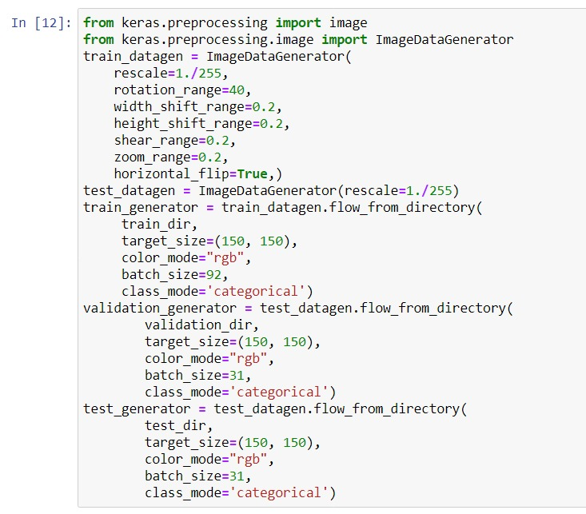
Data Augmentation & Re-scaling

Slide 16
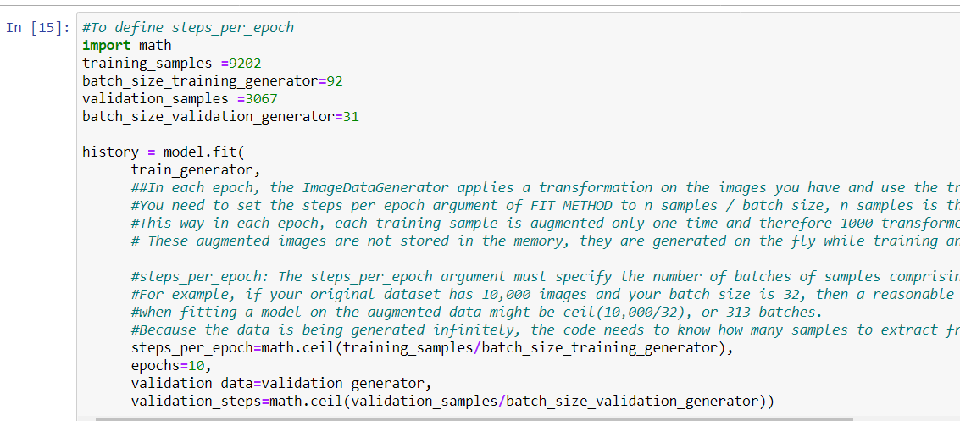
Training Model

Slide 17
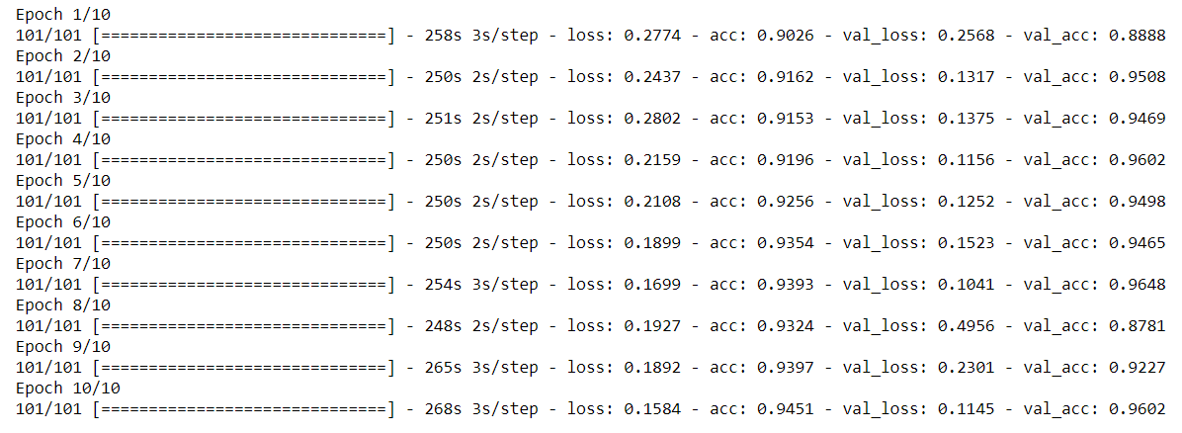
Output of our Training model

Slide 18
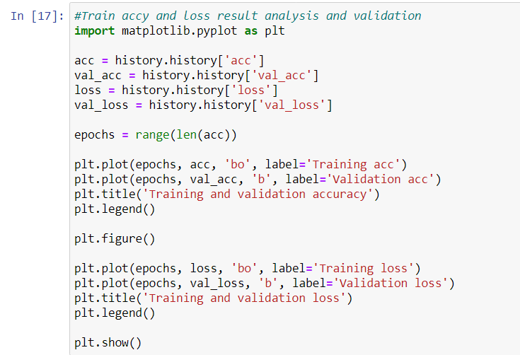
Training & Validation

Slide 19
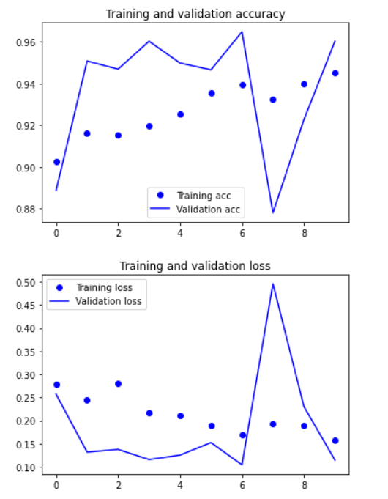

Slide 20
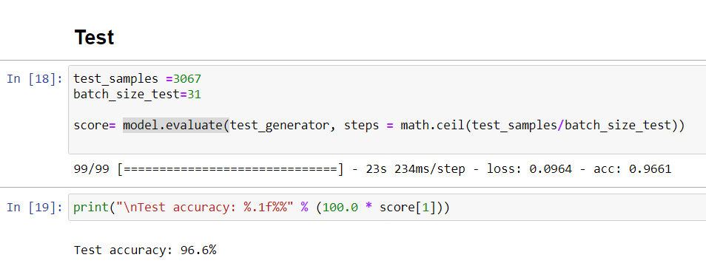
Testing samples & Attained Accuracy Rate

Slide 21
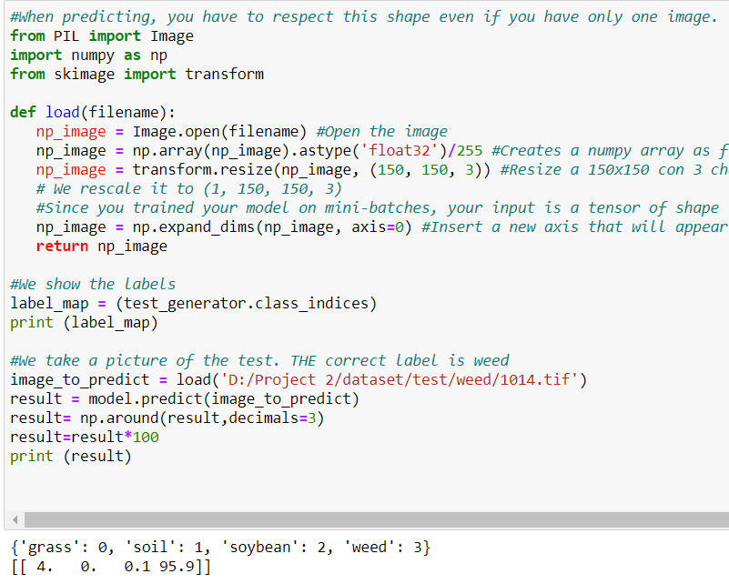
Final Prediction of the Model

Slide 22
FUTURE ENHANCEMENTS:
In future, we can improve the system (application) to analyze the soil and can figure out whether that land is suitable for crop growth or not.
The application can also be enhanced to suggest the correct amount of agrochemicals for utilization.
It can be extended to detect pests and plant diseases after slight modifications.

Slide 23
REFERENCES:
Mansoor Alam, Muhammad Shahab Alam, Muhammad Roman, Muhammad Tufail, Muhammad Umer Khan, Muhammad Tahir Khan ; “Real-Time Machine-Learning Based Crop/Weed Detection and Classification for Variable-Rate Spraying in Precision Agriculture ”, 2020 7th International Conference on Electrical and Electronics Engineering.
J. Ahmad, K. Muhammad, I. Ahmad, W. Ahmad, M. L. Smith, L. N. Smith, D. K. Jain, H. Wang, and I. Mehmood, “Visual features based boosted classification of weeds for real-time selective herbicide sprayer systems,” Computers in Industry, vol. 98, pp. 23–33, 2018.

Slide 24


